Slide 2
Workplace Evolution

Slide 3
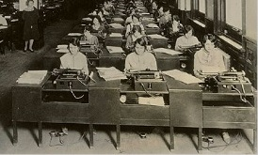
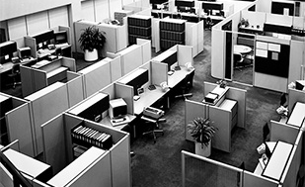
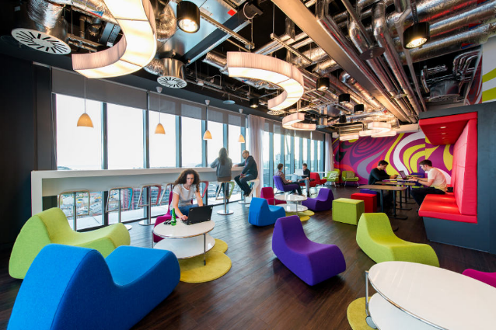
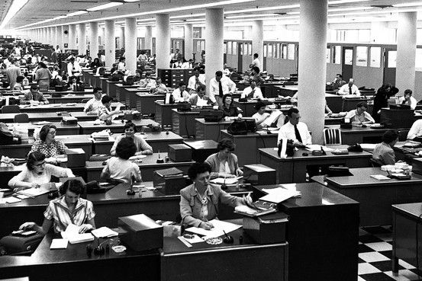
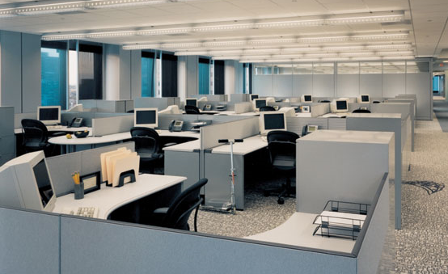
Timeline of Workplace
Open Office Workspaces
First Cubicle
Cubicles / Open Office
Google Dublin
1950s
1980s / 1990s
1920s
1964
2000s / Today
Herman Miller Action Office
Universal Office & Office as Status
Flexible / Collaborative
Notes:
Where we started… open office, but without any focus on collaboration, just an organization method
1950’s – private office as a status symbol
Today – flexible, collaborative

Slide 4

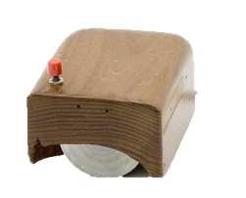
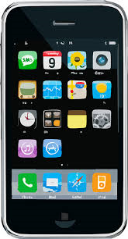
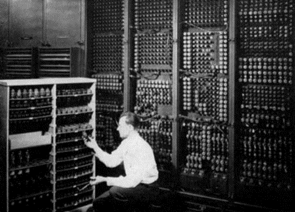
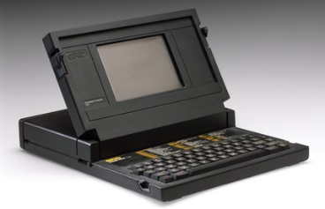
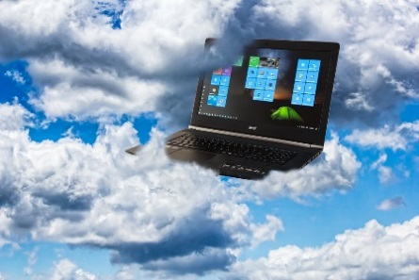
Electric Typewriter
Computer Mouse
IPhone
1946
1981
2007
1914
1963
2008
First Computer
Laptop
Cloud Computing
Notes:
How technology has changed and is changing how we work

Slide 5
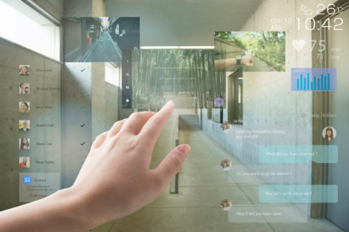
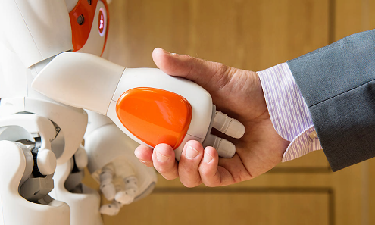
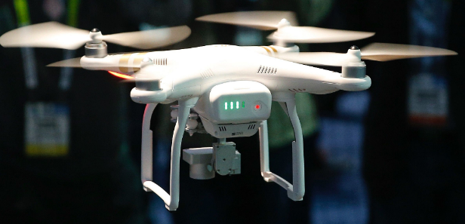

Industrial Revolution 4.0
Augmented Reality
Robots
Nic Delves- Broughton/PA
Drones
Virtual Reality
Notes:
Where we are today – AR/VR… seeing the introduction of robotics in healthcare
Constant change

Slide 6





Technology
1.5 Years
Organization
3 Years
Rate of Change
Workspace
10 Years
Workforce
8 Years
Building Envelope
40 Years
Notes:
Due to continuous change, we need to build for flexibilty

Slide 7
The Importance of Generational Diversity
88% of millennials wish they could have greater opportunity to start and finish work when/where they choose
Deloitte Millennial Survey
Millennials Dominating the Workforce
Notes:
Not just about milenials, but rather understanding that the makeup of the workforce is changing drastically and will continue to do so… again, build for flexibility

Slide 8



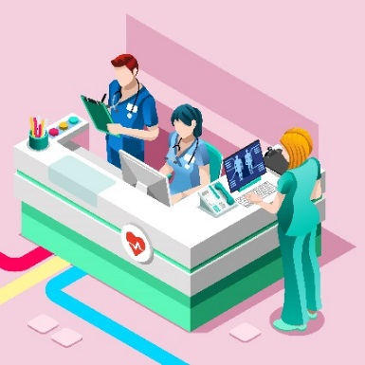


Office
Home
Collaboration
Clinical Spaces
Anywhere
Evolving Workplace
Mobile Technology
Notes:
New typical working environments being facilitated by mobile technology – important to discuss the application to healthcare and the idea of working across a system

Slide 9
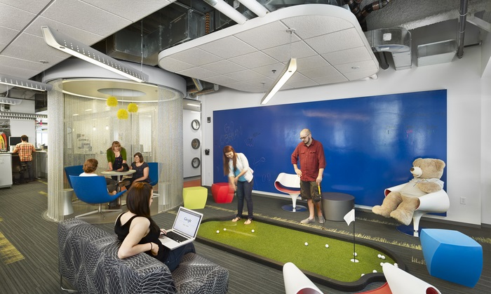
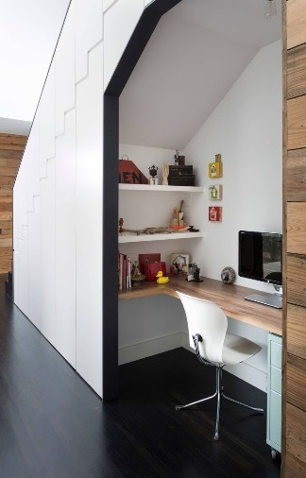
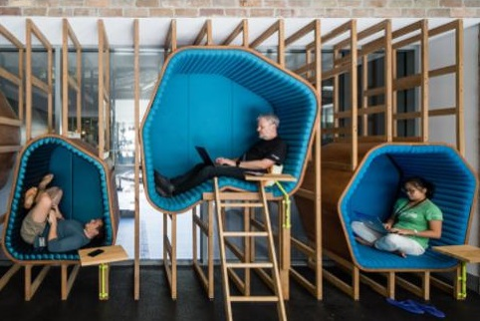
Work Anywhere
Productivity Increases 15-55%
75% of teleworkers say they could continue to work in the event of a disaster compared with just 28% of non-teleworkers.
3.6 less sick days / year
14% of Americans have changed jobs to
shorten commute.
75% of retirees want to continue to work if they have flexibility to enjoy retirement
Google Cambridge
Home Office,
HJR Architects
*Information provided by Bankrate & Global Workplace Analytics.
The State of Telework in the U.S.
Google Sydney
Notes:
This slide is speaking to remote workers, not necessarily docs/clinicians

Slide 10

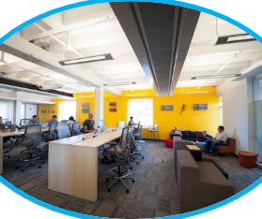
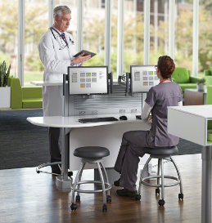
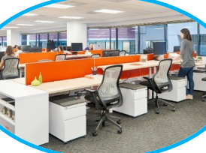






The Strategic Coalition: Space + HR + IT
Virtual Collaboration
Space
HR
IT
Work Anywhere/ Workbar
Collaborative
Workspace
Hoteling
Cloud Based Systems
Clinical IT Innovations
Connectivity
(All locations)
Policies & Procedures
E-Work
Recruit & Retain Talent
Notes:
This coalition is VITAL to making this type of working environment important – without one of them, it fails

Slide 11
Types of Space within an Office
Small, Open Meeting Spaces
Hotel
Huddle
Private Office
Open Workstations
Coffee Bar
Conference
Source: Knoll, Shaping the Work Experience, Dr. Michael O’Neill, Senior Director, Workplace Research, Knoll, Inc. 2012
Notes:
Talk about the many types of work spaces and the importance of varied solutions

Slide 12
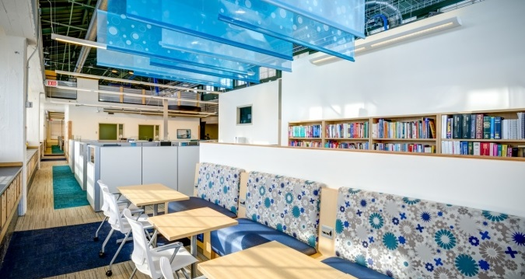
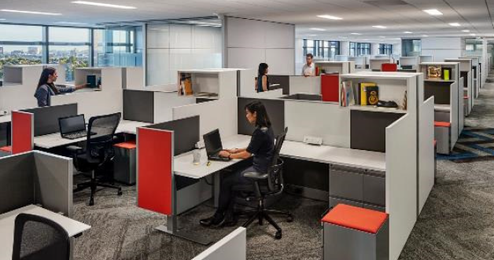
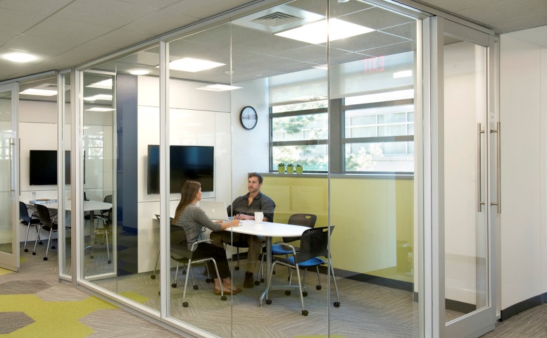
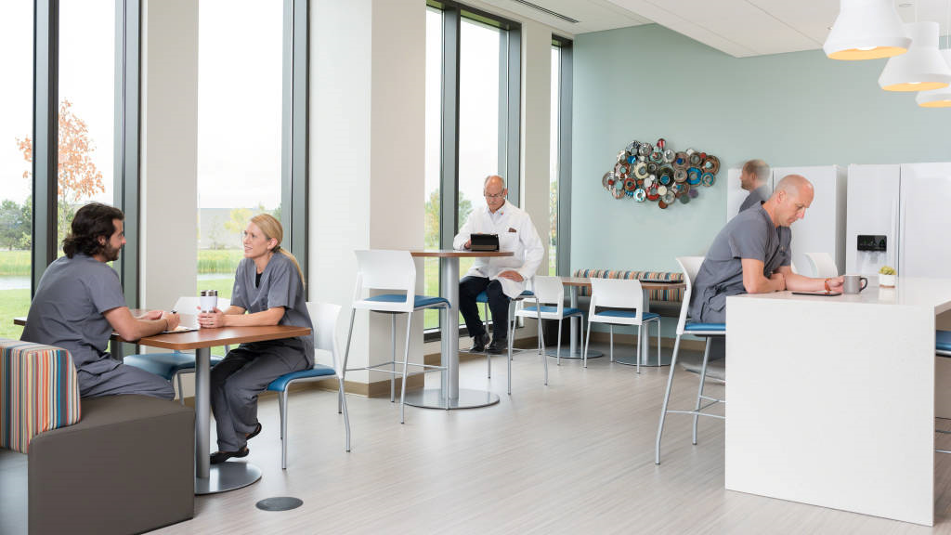
Work Anywhere Options
Cincinnati Children’s
by RCF Group
Partners Healthcare - Knoll
Collaboration Area
ThedaCare Regional Cancer Center
Notes:
Speak to the visual of the multiple space types as presented in the previous slide

Slide 13
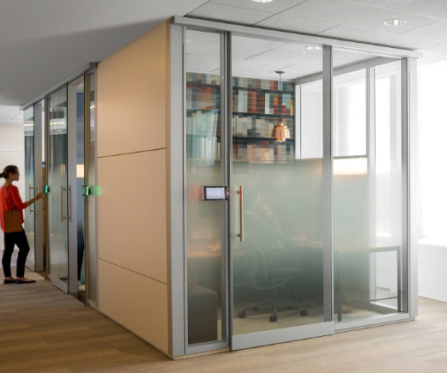
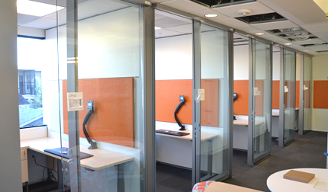
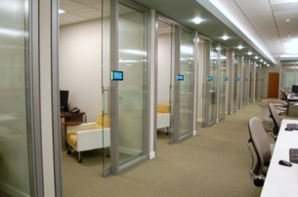
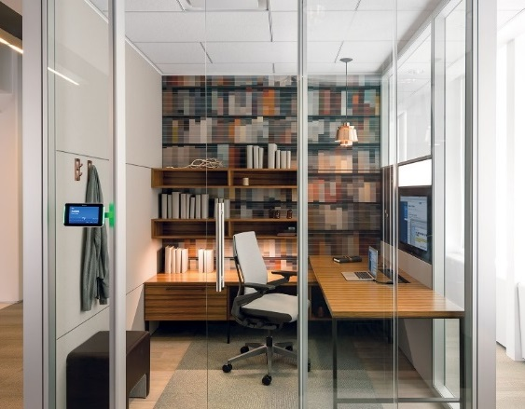
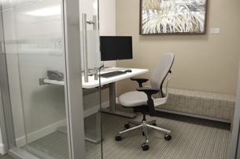
Primary Workspace
A Leading Health Consortium 6x8
Steelcase VIA
Steelcase CEO Office
Notes:
Speak to the visual of the multiple space types as presented in slide 11; these examples are all from healthcare (except the steelcase CEO) – talk to the idea that facilities are changing and moving this direction… i.e. it can and is being done

Slide 14
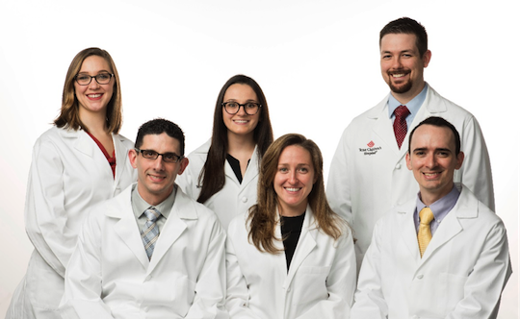
Recruiting and Retaining Talent
The World Health Organization estimates the world needs an additional 12.9 million skilled health professionals including midwives, nurses and doctors by 2035.
By 2025, the U.S. alone will have a shortage between 61,700 - 94,700 doctors per the AAMC.
Per Hospitalist, young doctors moving away from treating patients to non-clinical roles.
Physician Assistant Pediatric Surgical Fellows at Texas Children’s Hospital
Notes:
This is why it matters – recruiting and retaining talent. It’s essential to create spaces that support this driver, which doesn’t have to be based around office size.

Slide 15

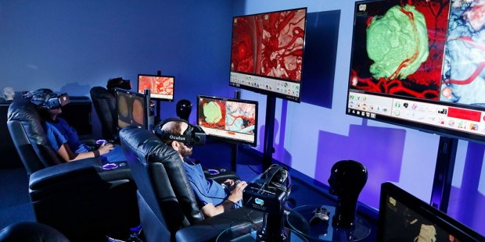
Student expectations in the workplace
Collaborative work: Students learning in Team Based Care Models in Medical School, Social collaboration technology
Advanced technology: Virtual clinics, IBM Watson, smart phones and trackers
Flexibility: Work anywhere, work/life balance. Per Bentley University, 77% of Millennials say flexibility in the workplace would create more productivity for employees their age.
Wavebreakmedia / Getty Images
Stanford Neurosurgical Simulation Lab
Notes:
Education facilities are collaborative, infused with tech, and students have higher expectations – tie back to the idea of generational diversity and the change in the workforce

Slide 16
Benchmarking Data

Slide 17
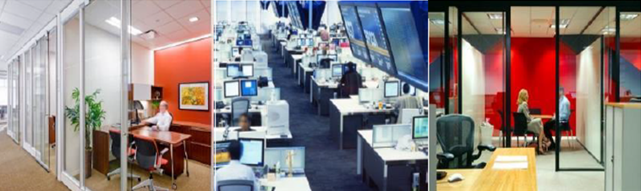
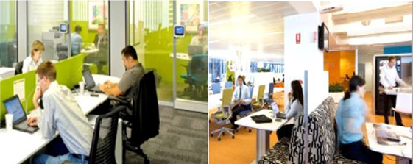
Private Office | Open Plan | Activity-Based Plan | Hybrid Mobility | Full Mobility
Fully assigned offices and/or high partition workstations | Fully assigned open plan workstations | Fully assigned open plan workstations and support space | Mix of unassigned and assigned workstations and support spaces | Fully unassigned workstations and support spaces
>250 dgsf per person | 200-250 dgsf per person | 150 dgsf per person | 100-150 dgsf per person | 50-100 dgsf per person
dgsf=Department Gross Square Footage
*Images provided by JLL
Notes:
Speak to the space impact of different planning solutions

Slide 18
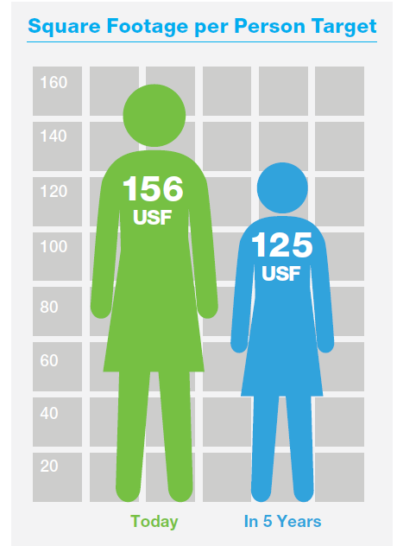
Technology Companies
Financial Companies
Mobile Worker
47 sf
Millennials
Mobile Worker
32 sf
Millennials
45%
45%
Call Center Agent
74 sf
Ind. Contractor
36 sf
Ind. Contractor
88 sf
Gen X
Call Center Agent
41 sf
Gen X
Admin Support
92 sf
35%
Admin Support
57 sf
29%
Technician / Professional
97 sf
Technicians / Professionals
60 sf
Mid-level Mgr
104 sf
Boomers
Mid-level Mgr
88 sf
Boomers
Sr Mgr / Director
109 sf
20%
Sr Mgr / Directors
124 sf
26%
Exec. Mgt
170 sf
Exec. Mgt
196 sf
Law Firms
Energy Companies
Mobile Worker
51 sf
Millennials
Mobile Worker
64 sf
Millennials
35%
39%
Call Center Agent
53 sf
Call Center Agent
66 sf
Admin Support
70 sf
Gen X
Admin Support
68 sf
Gen X
Ind. Contractor
98 sf
33%
Ind. Contractor
74 sf
32%
Jr Attorney / Paralegal
105 sf
Jr Attorney / Paralegal
111 sf
Mid-level Mgr/Attorney
147 sf
Boomers
Mid-level Mgr / Attorney
148 sf
Boomers
Sr Mgr/ Attorney
177 sf
32%
Sr Mgr / Attorney
213 sf
29%
Exec. Mgt/ Partner
227 sf
Exec Mgt/ Partner
383 sf
*Information provided by Knoll.
Notes:
Other industries are doing this as well and facing the same struggles. Healthcare is behind the times. Generational diversity/expectations play a role in this changing number, which will continue to drop…

Slide 19
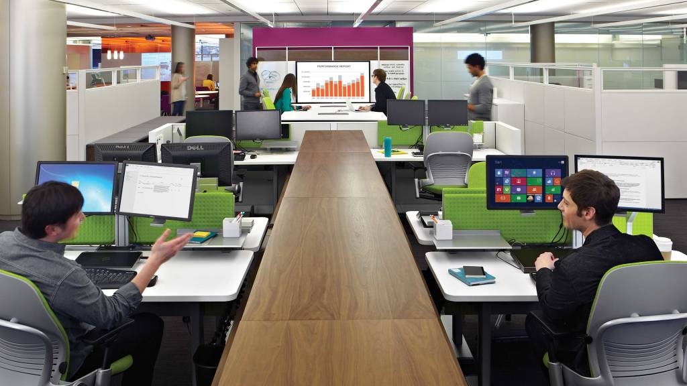
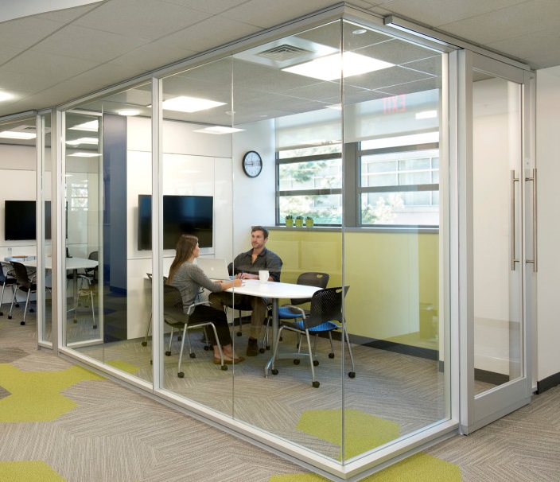
Healthcare Workplace
Offices are utilized 23% of the time during a typical work day.
Privacy on demand rather than privacy as a luxury.
Job Type | Occupancy %
Clinical Faculty | 12%
Clinical Fellow | 13%
Research Faculty | 22%
Researcher | 26%
Staff | 57%
Student | 17%
Steelcase
*Information by Herman Miller, UCSF School of Medicine Workplace Research Study Mission Hall by Perkins and Will
Notes:
Offices are not utilized efficiently by the majority of users, but space needs should be driven by need/work style (see researcher); concept is to reallocate space by need and provide privacy as required, not a given luxury

Slide 20
Healthcare Facilities Benchmarking
 | Location | Exec. |  | Chiefs / Deans / Dept. Chairs |  | Physician / Faculty Lead |  | Faculty / Tenure / Professor |  | Fellows / Residents |  | Directors |  | Managers |  | Staff
Pediatric | Hospital A |  |  |  |  |  |  |  |  |  |  | PO | 120 | PO | 80 | WS | 42
 | Hospital B | PO |  | PO | 120 | PO | 120 |  |  |  |  | PO | 120 | PO/SO | 120 | WS | 36
 | Hospital C | PO | 240 | PO | 160 | PO | 100-160 | SO/WS | 30-135 | SO/WS | N/A | PO | 100-160 | PO/SH/ WS | 80-135 | SO/ WS | 60-100
 | Hospital D | PO | 125-160 | PO | 125 | PO | leadership Determined | SO/WS/DI | leadership Determined | SO/WS/DI | 36-48 | PO | 125 | SO/WS/DI | 36-48 | SO/WS/DI | 36-48
 | Hospital E | WS | 48 | PO | 200 | PO/SO | 120 | WS | 48 |  |  | WS | 48 | WS | 36-48 | WS | 36
 | Hospital F | PO | 180 | PO/SO | 180 | PO/SO | 120 |  |  |  |  | PO | 120 | PO | 100-120 | WS | 36
 | Hospital G | PO | 200-300 | PO | 120-275 | PO/SO/ WS | 55-120 | PO/ SO | 120 | WS | 25-45 | PO/SO | 120 | PO/SO/ WS | 55-120 | SO/WS | 25-60
 | Hospital H | PO | 200-300 | PO | 250 | PO | 115 | PO | 120 | SO/WS/ WR | 64-115 | PO | 115 | SO/WS | 64-115 | WS | 64
Adult | Hospital A |  |  |  |  |  |  |  |  |  |  | WS | 48 | WS | 48 | WS | 48
 | Hospital B |  | N/A |  | N/A | PO/SO | 80-120 | PO/SO | 80-120 | DI/WS | 48-80 |  | N/A |  | N/A |  | N/A
 | Hospital C | PO | 200 | PO | 200 | PO | 120 | PO | 120 | WS | 25 | PO | 110 | PO/WS | 64-110 | WS | 64
 | Hospital D |  |  |  |  |  |  | PO/SO | 70-75 |  |  | PO/SO | 70-75 | PO/SO | 70-75
 | Hospital E | PO | 15-400 | PO | 150-240 | PO | 120 | PO | 120 | WS | 60 | PO/SO | 60-120 | PO/SO | 60-120 | SO/WS | 60
 | Hospital F | PO | 260 | PO | 140 | PO | 125 | PO | 120 | WS | 137 | PO | 140 |  | 120 |  | 40-100
 | Hospital G | PO | 120 | PO | 150 | PO | 130 | PO | 130 | SO | 120 |  |  | PO | 120 | WS | 45
 | Hospital H | PO | 160 | PO | 300 | PO | 160 | PO/ SO | 100-120 | WS | 36 | PO | 100 | WS | 64 | WS | 36-64
PO – Private Office, SO – Shared Office, WS – Workstation, DI – Drop-in/Dayuse, SS – Shared Space, WR – Workroom
Notes:
FKP | CD reviewed 8 adult facilities and 8 leading pediatric facilty space allocation standards → don’t linger here, it’s just to show where we got the averages on the next slide

Slide 21
Healthcare Facilities Benchmarking
Location | Exec. | Chiefs / Deans / Dept. Chairs | Physician / Faculty Lead | Faculty / Tenure/ Professor | Fellows / Residents | Directors | Managers | Staff
Pediatric Averages | 187 sf | 182 sf | 116 sf | 85 sf | 37 sf | 113 sf | 87 sf | 48 sf
Adult Averages | 203 sf | 213 sf | 126 sf | 110 sf | 74 sf | 93 sf | 86 sf | 56 sf
Case Study X | 200-300 sf | 200-275 sf | 55-120 sf | 120 sf | 25-45 sf | 120 sf | 55-120 sf | 25-60 sf
High End
Medium
Low End
Notes:
Averages from previous slide as compared to the space standards from a leading pediatric hospital
Since this is your last big information slide, I would speak to the importance of changing mindsets away from an allocated space standard based on hierarchy, but to a solution based around need, collaboration, flexibility of work types and styles, and providing popular amenities and upgraded spaces

Slide 22
Strategic Thoughts

Slide 23





Workplace Change Management
create the
BIG MESSAGE
12-18 MONTHS BEFORE
TAKE THE PULSE
of the organization
3-6 MONTHS BEFORE
DELIVER
the message
SUPPORT
the move
MOVE IN
EVALUATE
the process
3-6 MONTHS AFTER
*Information from Knoll

Slide 24
Questions?

