Slide 1
AAAP/AMSPDC Collaboration: Effort Project/Future Initiatives
Stephen R. Daniels, MD, PhD
Elaine Gallagher

Slide 2
History
Boards of AMSPDC and AAAP agreed to collaborate more closely (January – August, 2014)
Survey of AMSPDC and AAAP members to identify topics for collaboration (October, 2014)
“Faculty Effort” selected as topic for initial collaboration (December, 2014)
Cross-representational workgroups formed by effort category, co-chaired by chair and administrator dyad (January, 2015)
Summaries compiled (May, 2015)

Slide 3
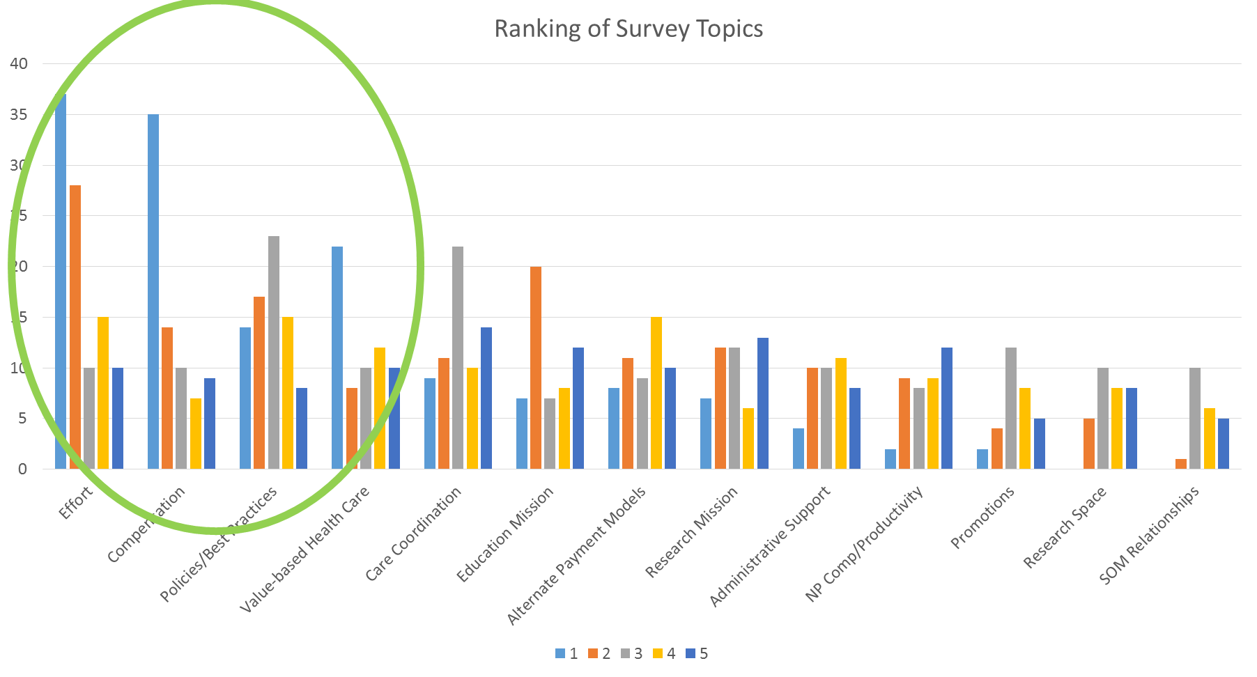

Slide 4
Goals of Collaboration
Learning experience:
One area of focus
Concrete project with tangible results
Broad representation:
Chairs
Administrators
Range of department sizes
Variety of organizational structures
Geographical range

Slide 5
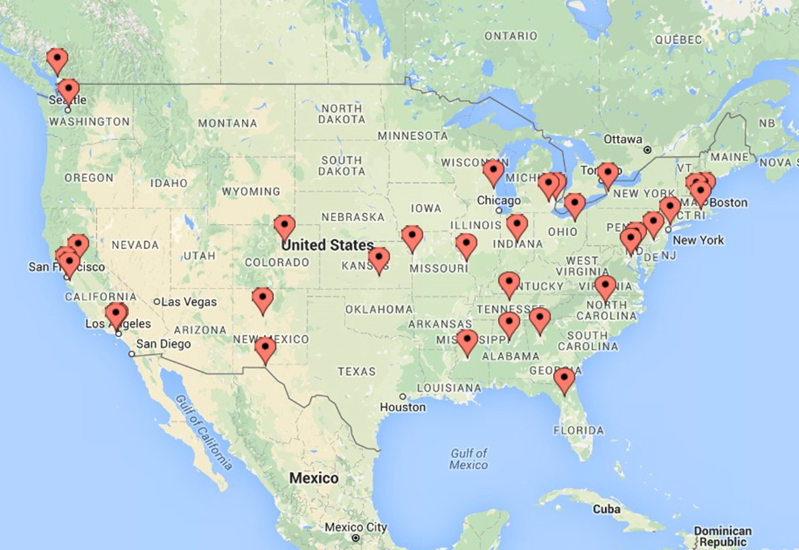

Slide 6
Outcome
Newsletter – on AAAP and AMSPDC website
Summary of work – reference document
Key principles and current practices
List of unresolved issues
List of committee members

Slide 7
Lessons learned
Worthwhile, productive activity
Initial meetings via telephone less than optimal
Role clarification/infrastructure needed to support additional work
Meeting scheduling
Minutes/task coordination

Slide 8
Where do we go from here?
Steering Committee
Volunteers needed:
Two chairs
One administrator
Collaborate on another project
Value-based health care
Care coordination
Volunteers needed:
Co-chairs
Workgroup members
Joint AMSPDC –AAAP educational meeting – Fall 2017?
Advisory Board speaker/facilitation
Volunteers needed:
Content planners
Site planners
Joint webinars using existing AMPSDC format
Volunteers needed:
Content planners

Slide 9
Contacts
If you have questions/comments or wish to volunteer to serve in one of these roles, please contact:
Laura Degnon at laura@degnon.org
Elaine Gallagher at gallaghere@email.chop.edu

Slide 10
Appendix
List of participants
Focus of workgroup

Slide 11
Participating Members: Steering Committee
Stephen R. Daniels, MD, PhD (U Colorado, Denver)
Hugh O’Brodovich, MD (Stanford)
D. Brent Polk, MD (CHLA)
Elaine Gallagher (CHOP)
Erin Allen (U Washington)
Alison Marx (CHOP)

Slide 12
Clinical Effort Workgroup
Co-Chairs:
Rob Lane, MD, (Medical College of Wisconsin)
Beth Kalberg (Children’s Mercy, Kansas City)
Members:
Michelle Barnett (Univ Michigan)
Wesley Burks, MD (Univ North Carolina)
Norman Christopher, MD (Akron Children’s)
Loretta Cordova De Ortega, MD (Univ New Mexico)
Bryan Downey (Colorado Children’s)
Allison Eddy, MD (BC Children’s and Women’s)
Tina Gray (St. Louis Univ)
Michael Probst (Stanford)
Non wRVU activities
Indirect care
Team productivity
Benchmark adjustments
FFS vs Population Health impact
Outreach
Downstream referral impact
How do we model for changes in macro/micro economics?

Slide 13
Research Effort Workgroup
Definitions (CE vs Phys Scientist)
Unfunded research effort
Initial track assignments
Academic vs Research time
Junior Research faculty
Co-Chairs:
Judy Aschner, MD (Albert Einstein/Montefiore)
Sandie Bolina (Vanderbilt)
Members:
Wade Clapp, MD (Indiana)
Sharon Devaskar, MD (UCLA)
Kerstin Hildebrandt (Children’s National)
Liz McCarty (Emory)
Robin Steinhorn, MD (UC Davis)
How do we incentivize research similar to wRVU (clinical) productivity?

Slide 14
Education Effort Workgroup
Co-Chairs:
Bob Vinci, MD (Boston Med Ctr)
Patricia Segerson (U Mass)
Members:
Rick Barr, MD (U Mississippi)
Alicia Gacharna (TTUHSC)
David Ingram (U Alabama)
Phil O’Brien (UCSF)
Teresa Welch (U Florida)
Definition
Teaching in the clinical setting
How is the value of education defined?

Slide 15
Administrative Effort Workgroup
Co-Chairs:
Bruder Stapleton, MD (Univ Washington)
Gail Cohen (Colorado Children’s)
Members:
Jackie Burczyk (Kansas Univ Med College)
Loretta Cordova de Ortega, MD (Univ New Mexico)
Steve Czinn, MD (Univ Maryland)
James Dimond (Univ Michigan)
Steve Lipshultz, MD (Wayne State)
Teresa Quattrin (Children’s Buffalo)
Tracey Wallace (Univ Rhode Island)
George Weiss (CHLA)
Definition
Funding sources
Qualification for support
Promotion-eligible
How can we raise awareness/value for administrative activities?

